Slide 1
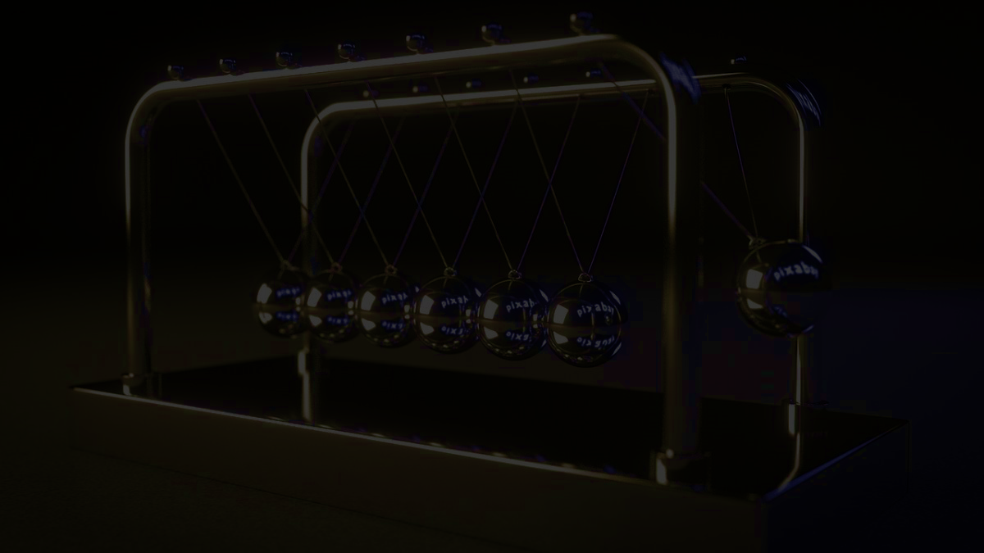
PhysiPlay
A revolutionary 2D physics simulator
Team GapeHorn123: Raiven Simbajon, Sunny Chen, Kevin Deng, Vinith Kanagaratnam

Slide 2
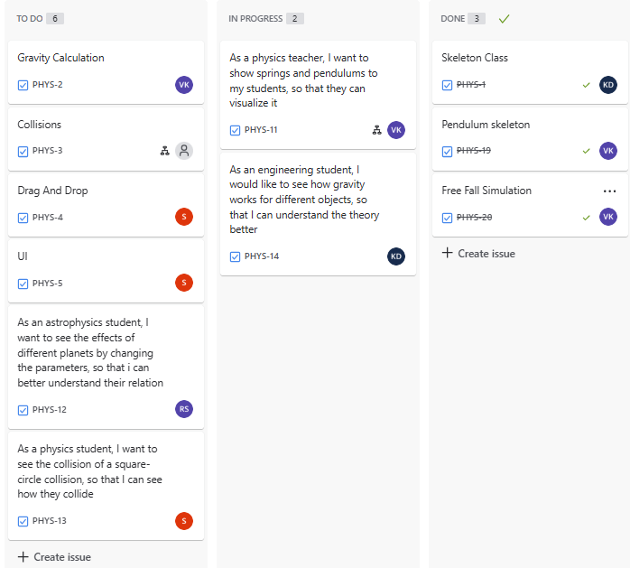
Tasks assignment

Slide 3
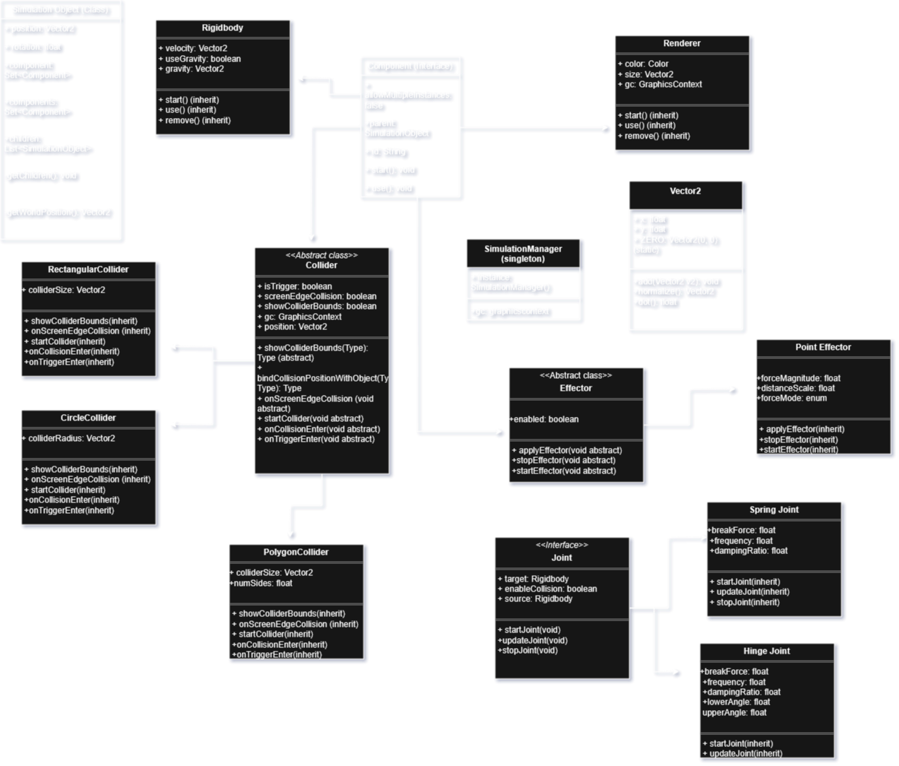
Class Diagram

Slide 4
Sample Input/Output
Input | Output
Drag-and-drop movement | Simulation objects in action
Mouse clicking | Switch scenes, hierarchy expansion, start/stop simulation, edit/creation of one object's attribute.
Text input | Edit/Creation of one object's attribute (name, velocity)
Mouse scroll | Scroll through files or scroll through the inspector and hierarchy menu.

Slide 5
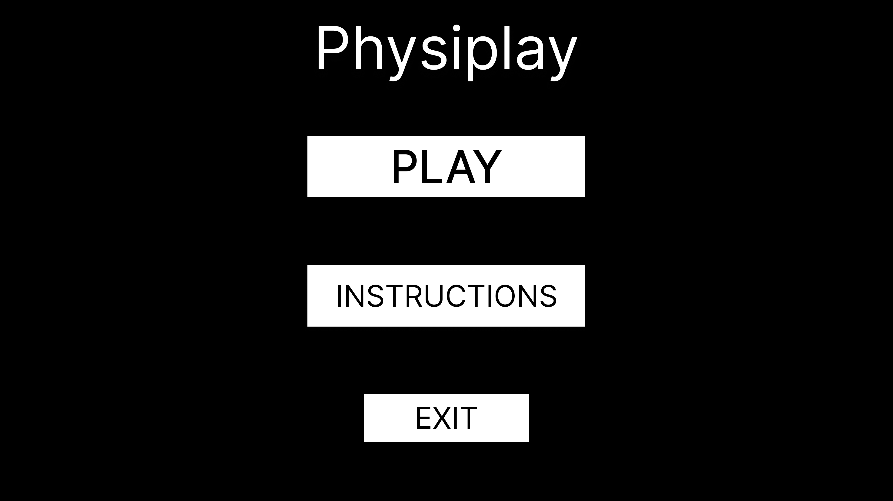
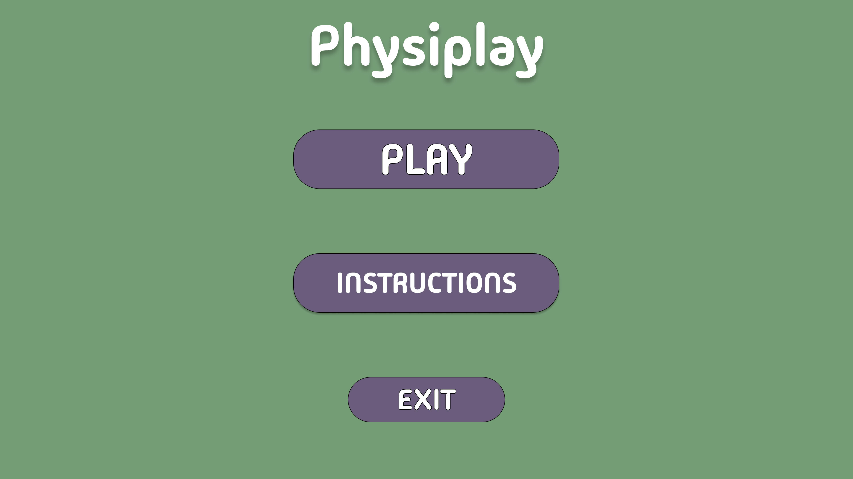
Wireframes and Mockups

Slide 6
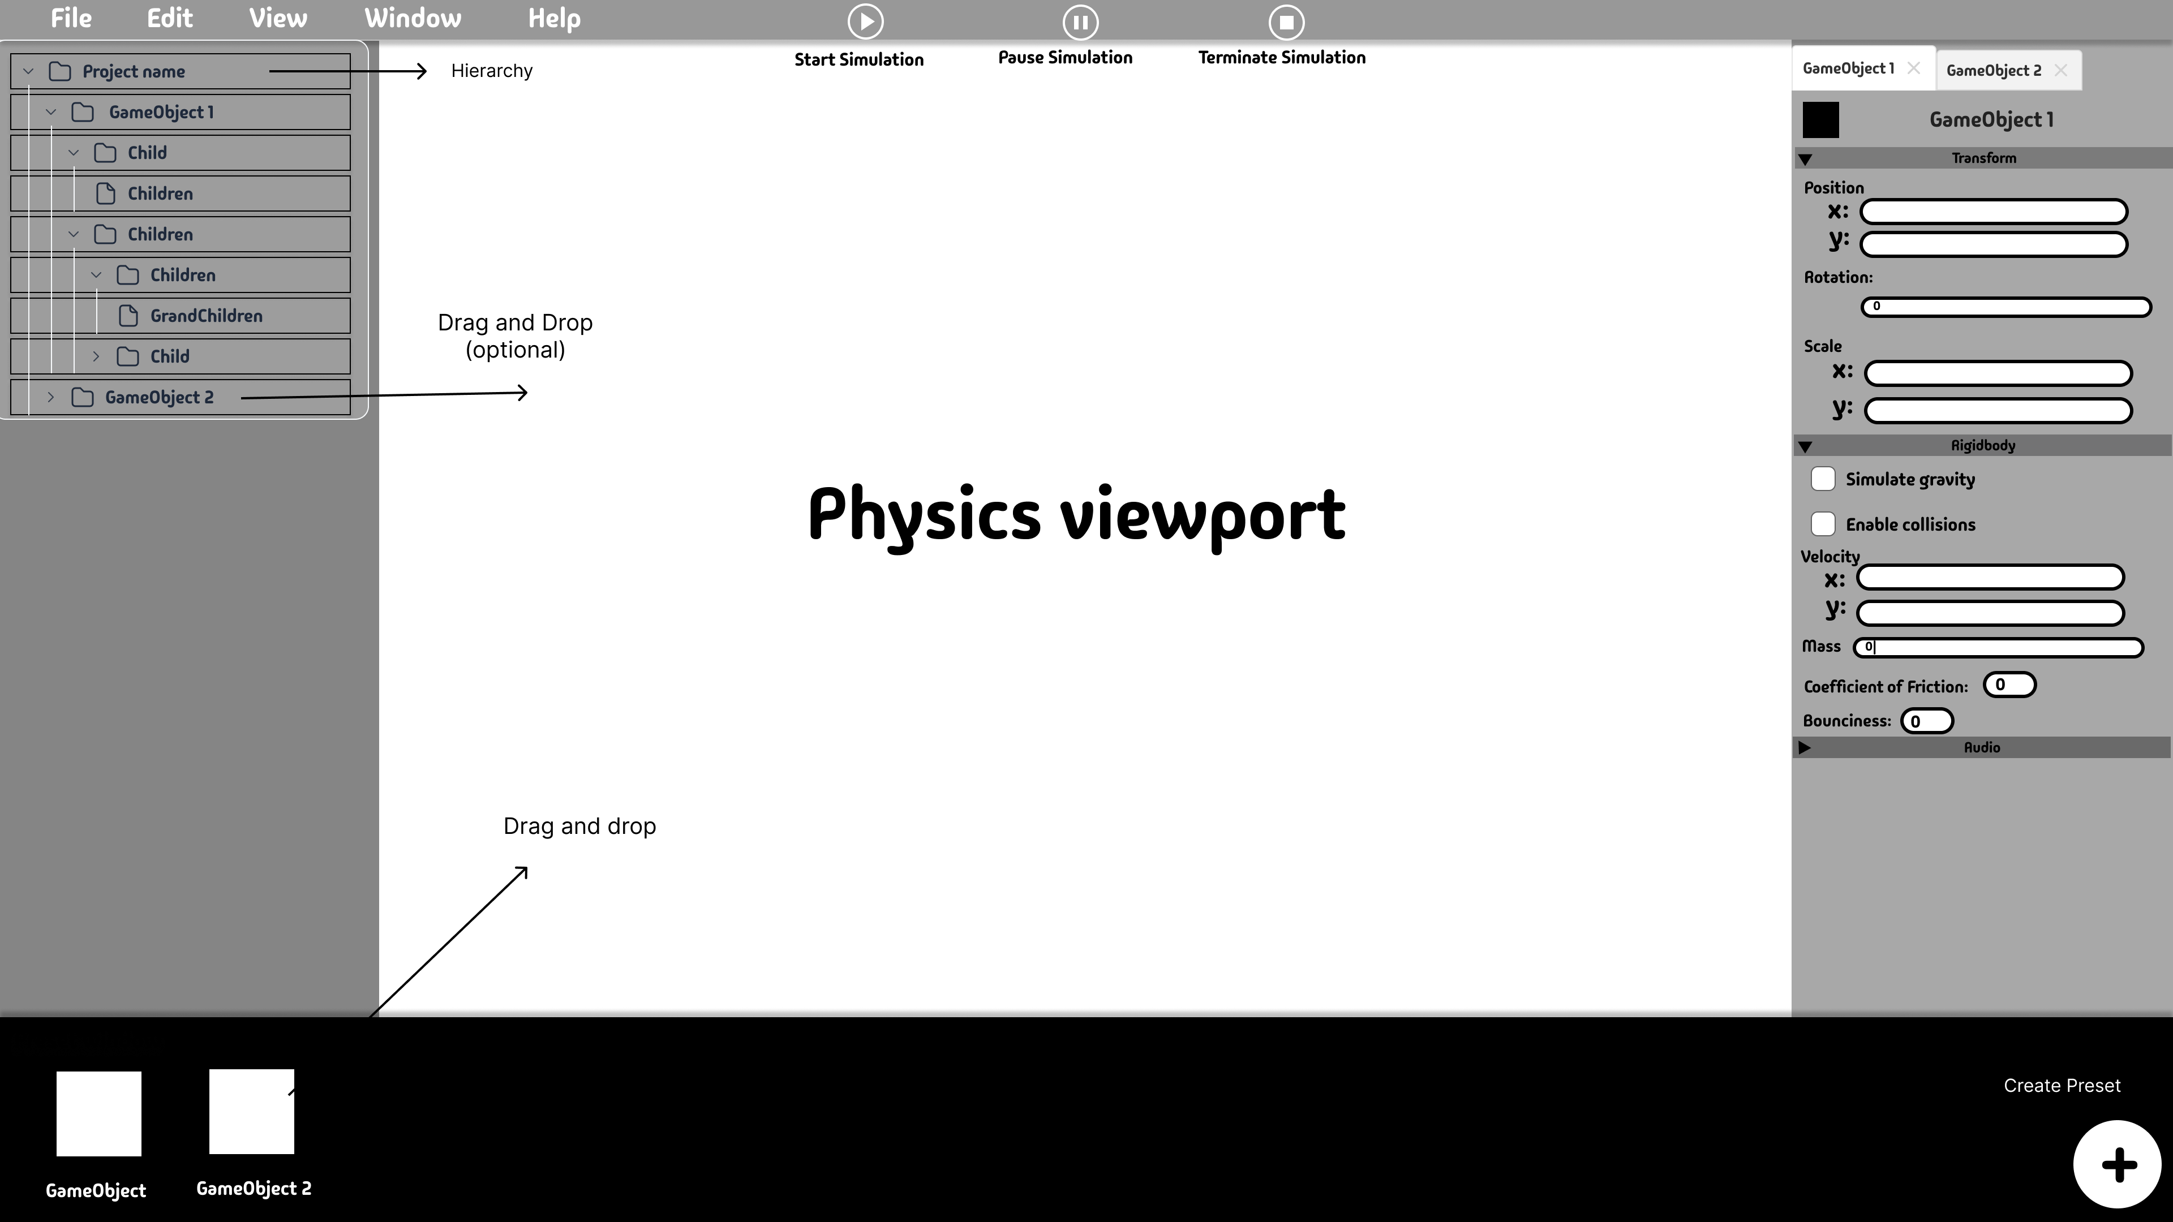
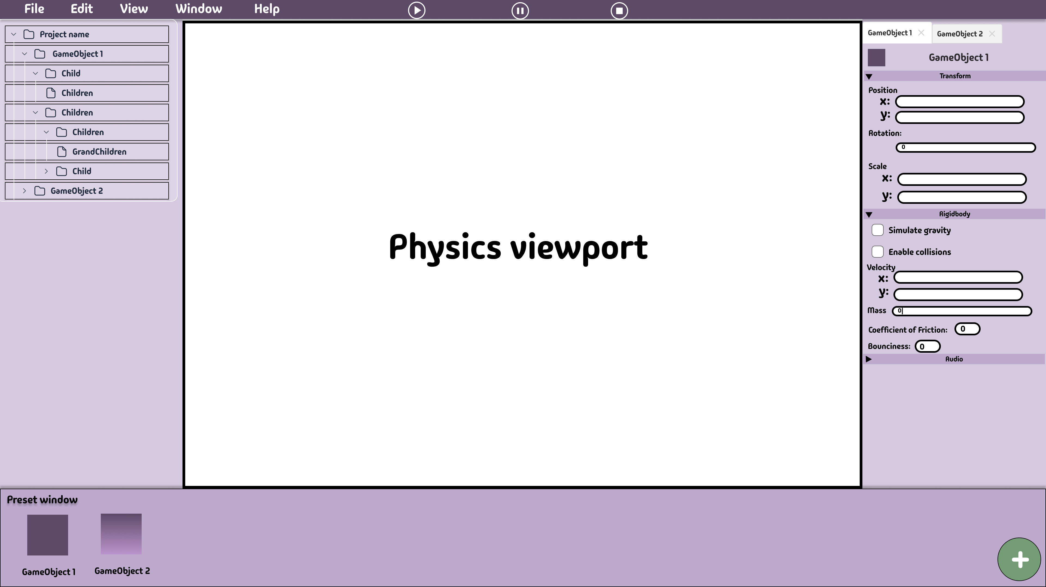
Wireframes and Mockups

Slide 7
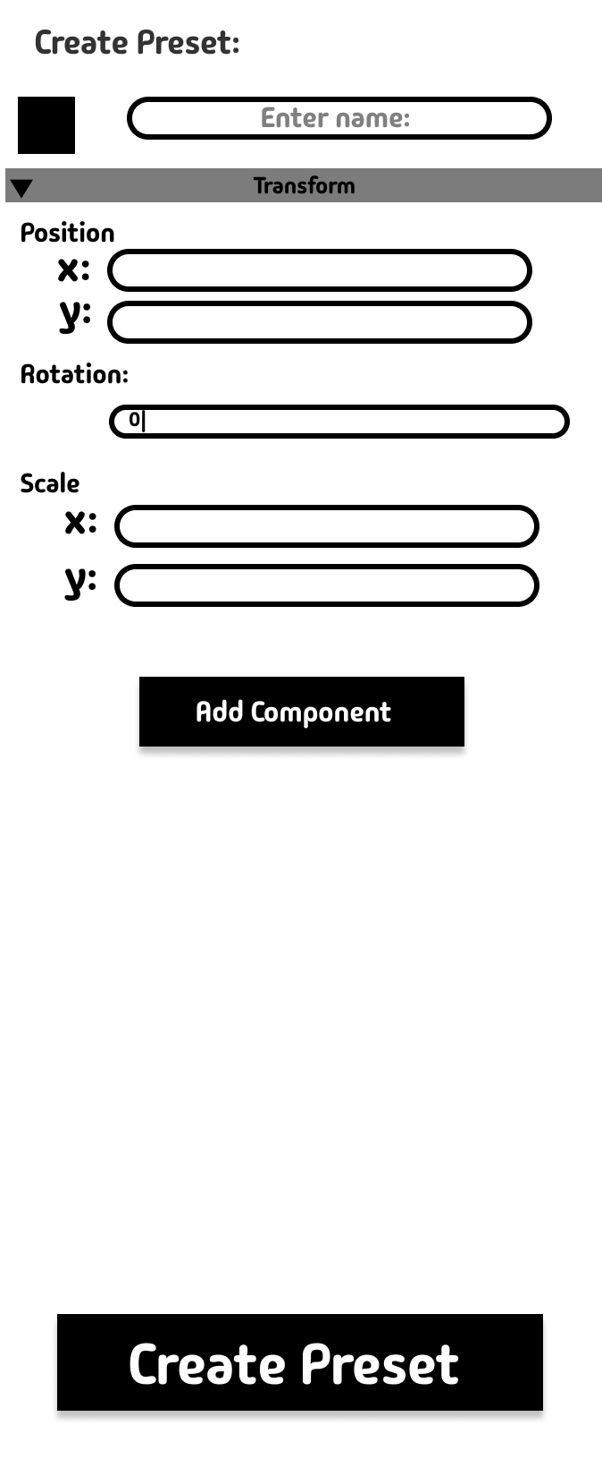
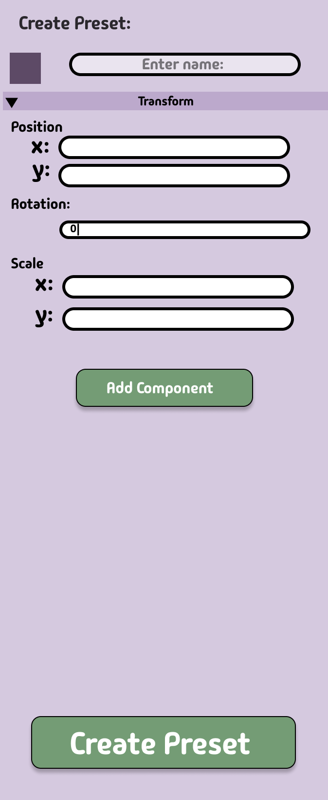
Wireframes and Mockups

Slide 8
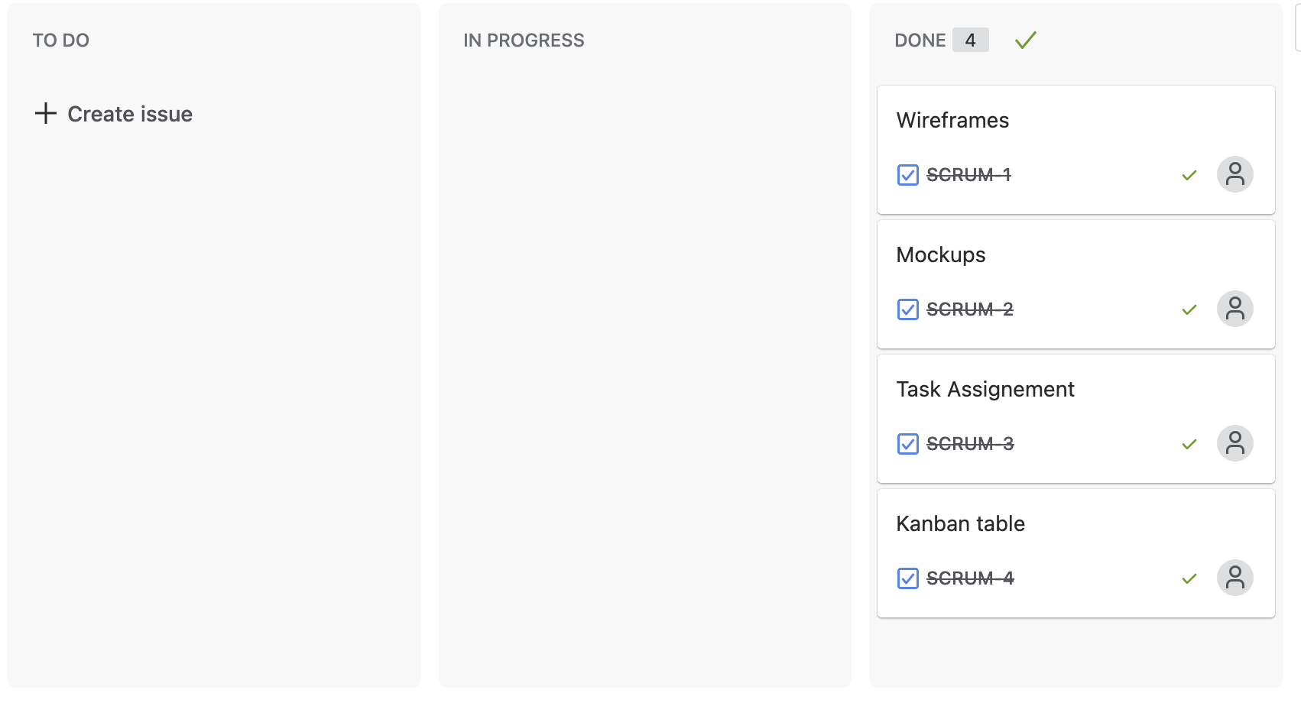
Sprint Report - Sunny

Slide 9
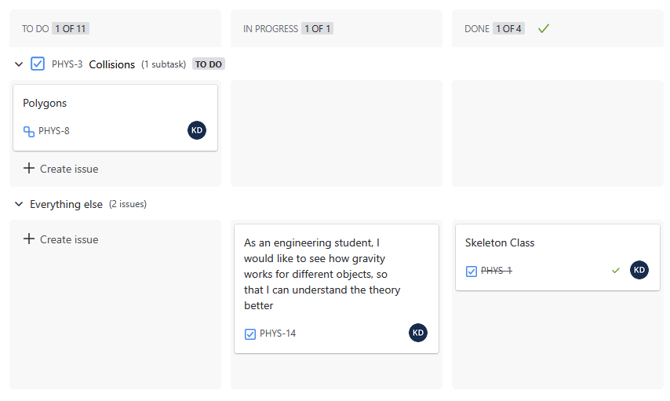
Sprint Report - Kevin

Slide 10
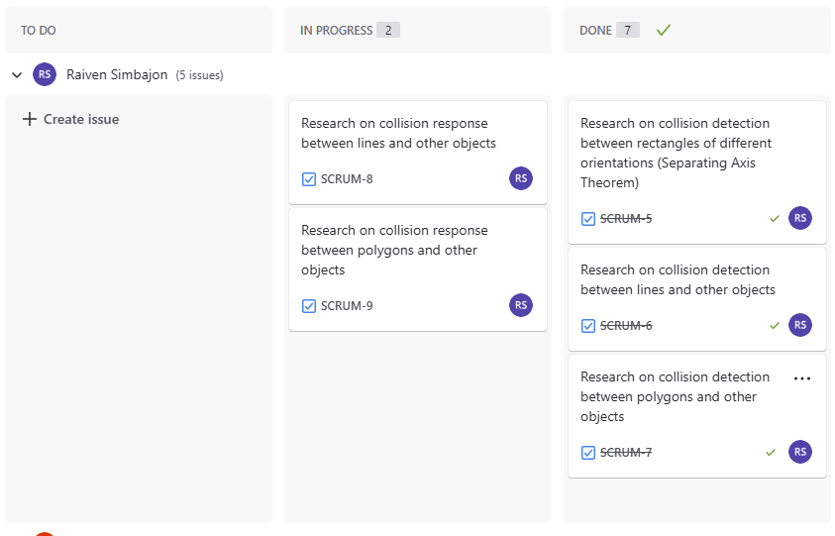
Sprint Report - Raiven

Slide 11
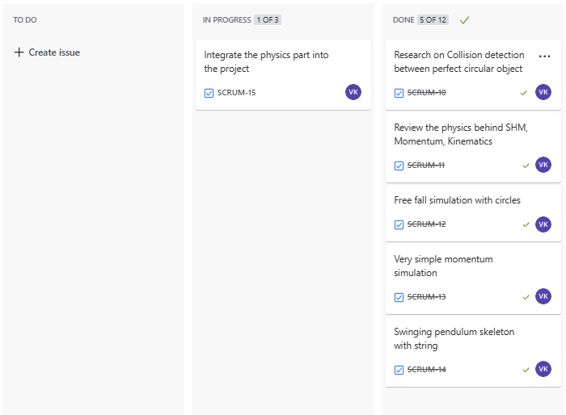
Sprint Report
Vinith

